Slide 1
Notes:
Lesson 4: Plant Nutrient Deficiencies – Page 118
Nourishing the Planet in the 21st Century
Download your free copy of the curriculum: https://www.nutrientsforlife.org/for-teachers.
Students consider how soil forms into layers called soil horizons that have distinct compositions and functions.
Topics Covered and Major Concept
Elaborate: Students deepen their understanding of the nutritional requirements of plants by diagnosing plant nutrient deficiencies. Crop plants with nutrient deficiencies show specific symptoms. These deficiencies can be corrected by using fertilizers that restore nutrient balance to the soil.
Alignment with Next Generation Science Standards
Science Practices in Lesson 4
Planning and Carrying Out Investigations
Analyzing and Interpreting Data
Using Mathematics and Computational Thinking
Constructing Explanations and Designing Solutions
Engaging in Argument from Evidence
Obtaining, Evaluating, and Communicating Information
Selected Disciplinary Core Ideas in Lesson 4
LS1.A: Structure and Function: Systems of specialized cells within organisms help them perform the essential functions of life.
LS1.C: Organization for Matter and Energy Flow in Organisms: The process of photosynthesis converts light energy to stored chemical energy by converting carbon dioxide plus water into sugars plus released oxygen.
LS1.C: Organization for Matter and Energy Flow in Organisms: As matter and energy flow through different organizational levels of living systems, chemical elements are recombined in different ways to form different products.
LS2.B: Cycles of Mater and Energy Transfer in Ecosystems: Photosynthesis and cellular respiration are important components of the carbon cycle, in which carbon is exchanged among the biosphere, atmosphere, oceans, and geosphere through chemical, physical, geological, and biological processes.
LS1:C: Organization for Matter and Energy Flow in Organisms: The sugar molecules thus formed contain carbon, hydrogen, and oxygen, their hydrocarbon backbones are used to make amino acids and other carbon-mased molecules that can be assembled into larger molecules (such as proteins or DNA) used, for example, to form new cells.
LS2.B: Cycles of Matter and Energy Transfer in Ecosystems: The chemical elements that make up the molecules of organisms pass through food webs and into and out of the atmosphere and soil, and recombine in different ways.
LS2.C: Ecosystem Dynamics, Functioning, and Resilience: Moreover, anthropogenic changes (induced by human activity) in the environment – including habitat destruction, pollution, introduction of invasive species, overpopulation, and climate change – can disrupt an ecosystem and threaten the survival of some species.
LS4.d: Biodiversity and Humans: Humans depend on the living world for the resources and other benefits provided by biodiversity. But human activity is also having adverse impacts on biodiversity through overpopulation, overexploitation, habitat destruction, pollution, introduction of invasive species, and climate change.
ESS3.C: Human Impacts on Earth Systems: The sustainability of human societies and the biodiversity that supports them require responsible management of natural resources.
ETS1.A: Defining and Delimiting Engineering Problems: Humanity faces major global challenges today, such as the need for supplies of clean water and food or for energy sources that minimize pollution, which can be addressed through engineering. These global challenges also may have manifestations in local communities.
ETS1.B: Developing Possible Solutions: When evaluating solutions it is important to take into account a range of constraints, including cost, safety, reliability, and aesthetics and to consider social, cultural, and environmental impacts.
Crosscutting Concepts in Lesson 4
Patterns
Cause & Effect
Stability and Change of Systems
Common Core Standards in Lesson 4
English Language Arts/Literacy
Anchor Standards
CCSS.ELA-LITERACy.CCRA.R.1
CCSS.ELA-LITERACy.CCRA.R.2
CCSS.ELA-LITERACy.CCRA.R.7
CCSS.ELA-LITERACy.CCRA.R.10
CCSS.ELA-LITERACy.CCRA.W.1
CSS.ELA-LITERACy.CCRA.W.9
CCSS.ELA-LITERACy.CCRA.SL.1
CCSS.ELA-LITERACy.CCRA.SL.2
CCSS.ELA-LITERACy.CCRA.SL.4
CCSS.ELA-LITERACy.CCRA.L.4
CCSS.ELA-LITERACy.CCRA.L.6
Math Standards
Standards for Mathematical Practice
CCSS.mATH.PRACTICE.mP2
CCSS.mATH.PRACTICE.mP4
The Nutrients for Life Foundation provides a search tool on their website, http://nutrientsforlife.org, allowing teachers to select their state and find soil science lessons that correlate with their state’s science standards. The search tool can align this curriculum with science standards for all 50 states, National Sciences Education Standards, Common Core State Standards, and Next Generation Science Standards.
In Elaborate lessons, students apply or extend previously introduced concepts and experiences to new situations. In the Elaborate lessons in this module (Lesson 4, Plant Nutrient Deficiencies and Lesson 5, Fertilizers and The Environment) , students make conceptual connections between new and former experiences, connecting aspects of their plant and soil investigations with their concepts of scientific inquiry;
connect ideas, solve problems, and apply their understanding to a new situation;
use scientific terms and descriptions;
draw reasonable conclusions from evidence and data;
deepen their understanding of concepts and processes; and
communicate their understanding to others.

Slide 2
Plant Nutrient Deficiencies
Lesson 4
Elaborate
Notes:
Overview – Page 118
Students discuss the definition of “fertilizer” and relate it to plant nutrition and the need to restore nutrient balance in the soil when farming. They discuss how people and plants can suffer from nutrient deficiencies. Students assume the roles of plant doctors and diagnose nutrient deficiencies in corn plants.
MAJOR CONCEPTS
• Plants, like people, require essential elements to be present in certain quantities in order to be healthy.
• Plants extract nutrients from the soil. In the case of crops, large portions of these nutrients are removed from the ecosystem when crops are harvested.
• Plants with nutrient deficiencies show specific symptoms.
• Fertilizers provide essential nutrients for plants.
• The soil is a “nutrient bank” that can hold a limited amount of nutrients. Fertilizers put more “money” in the bank by restoring nutrient balance to an agricultural soil.
TEACHER BACKGROUND
Consult the following sections in Teacher Background: 9.0 NUTRIENT DEFICIENCIES Of PLANTS, 10.0 NOURISHING PLANTS WITH FERTILIZERS
See pages 118-121 in Nourishing the Planet in the 21st Century high school curriculum for preparation instructions.

Slide 3
What we’re learning!
By the end of this lesson, you will be able to
recognize that plants, like people, require essential nutrients to be present in the right amounts in order to be healthy,
use reference materials to diagnose plant nutrient deficiencies,
define fertilizer as a type of “food” for plants, and
appreciate that fertilizers are used to replenish nutrients in agricultural soils.
Notes:
OBJECTIVES
After completing this lesson, students will be able to
• recognize that plants, like people, require essential nutrients to be present in the right amounts in order to be healthy,
• use reference materials to diagnose plant nutrient deficiencies,
• define fertilizer as a type of “food” for plants, and
• appreciate that fertilizers are used to replenish nutrients in agricultural soils.

Slide 4
Virtual Classroom – Lesson Introduction
Notes:
For more virtual classroom videos, visit the Nutrients4Life YouTube channel.

Slide 5
Review: How do plants get nutrients?
What happens to us if we don’t get enough of an essential nutrient?
What happens to plants if they do not get the nutrients they need?
Notes:
Activity 1: When A Plant Needs “Food” (page 122)
Begin the activity by asking students how plants get the nutrients they need for growth.
If necessary, remind students that in the previous lessons they explored how plants obtained nutrients from the soil through the roots and transported them through the xylem tissue to the rest of the plant. Students may also mention photosynthesis. If necessary, remind students that in the case of photosynthesis, “food” refers both to the essential element carbon, which accounts for about half the weight of the plant, and to the light energy that is trapped and used to power plant metabolism. There are two important points that need to come out of this discussion. First, as discussed in Lesson 1, plants require essential elements (building blocks) that are not supplied by photosynthesis.
Second, students should recall from Lessons 2 and 3 that essential elements are found in soil and absorbed by the plant through its root system.
Remind students that plants and people are both made of cells and those cells need nutrients to be healthy. Ask, “what happens to us if we don’t get enough of an essential nutrient?”
Student responses will vary. Students will recognize that when we have a nutrient deficiency, we get sick.
Continue the discussion by asking students to predict what might happen to plants if they do not get the nutrients they need. ask students to work independently to write their ideas in their notebook or on paper. After students have written their own ideas, ask them to share their ideas with the class. Record answers on the board or chart paper.
Keep this discussion moving and short. Accept all reasonable answers. Use probing questions to assess whether students think the plant’s response would be the same for all missing nutrients or whether there might be differences. Students will be investigating this question in the next activity and can revisit this list later.

Slide 6
www.nutrientsforlife.org/games/humanity/
Notes:
Activity 2: Humanity Against Hunger (page 122)
Decide whether you will use the web-based or print-based version of this activity.
If using the web-based activity, reserve computers for students to use and preview the activity so that you are familiar with the content on and navigation of the website.
TEACHER NOTE
Critical thinking is important to this activity. Not all of the information provided to students is helpful in identifying nutrient deficiencies. For example, the presence or absence of weeds in the fields is not a useful piece of information.
The web version of this activity can be accessed at www.nutrientsforlife.org/games/humanity/. One part of this activity, “Your Assignment for Humanity Against Hunger,” has an audio narration. If headphones are available, students can work at their own pace. In the event that neither headphones nor speakers are available for student computers, consider projecting the activity and showing the beginning of this part of the activity.
The web version allows students to type their initial observations into an online page that is identical to Master 4.3. However, the web program will not save this information. If you would like students to complete Master 4.3 as an assignment to turn in for a grade, you will need to provide them with a hardcopy of Master 4.3 and ask that they record their answers on it while conducting the simulation.
If the students’ computers are linked to a printer, then they can print an “Award of Merit” at the conclusion of the activity, which indicates that they completed all of the required steps correctly.
For this activity, divide the class into groups of 3 students. Each group will evaluate 3 case studies. If sufficient computers are available, allow each student to work alone.
At the home page, instruct the students to begin by clicking on “The Food Crisis In Africa.” Ask volunteers to read parts of the article .
This section serves as an introduction to agricultural issues in Africa and sets the stage for the next part of the activity during which students will investigate how nutrient deficiencies affect plant growth.
Pause for a moment after reading for a brainstorming session with the students . Ask, “Can you think of ways to help solve Africa’s food shortage problem?”
Instruct students to return to the home page and select “Your Assignment For Humanity Against Hunger.” At this point, the students will complete the web activity on their own, following the directions given on the website.
If you wish, project the first part of “Your Assignment for Humanity Against Hunger” up through the point where the narration gives instructions about what students will do during the activity.
When students have completed the assignment, ensure that they print out their evaluation reports to turn in to you .
After the assignment portion of the activity is completed, encourage students to explore the “Additional Resources/Links” section.

Slide 7
Humanity Against Hunger
You have been selected to join Humanity Against Hunger, an international effort dedicated to fighting hunger around the world. Your first assignment is to travel to Africa and help farmers from a small village.
In sub-Saharan Africa, nearly one-third of the population, almost 200 million people, lacks enough food to lead healthy, productive lives. Although some areas of Africa have rich soil and support plant growth, other areas do not. Growing food for the increasing human population is an important challenge. African farmers have traditionally cleared land, grown and harvested their crops, and then moved on to clear more land for the next planting. After harvesting their crops, the farmers left the land alone so that it would eventually regain its fertility.
However, increasing population growth has limited this traditional farming practice, which worked so well in the past. Today, farmers often grow crop after crop on the same land, “mining,” or depleting, the soil of its nutrients. Most of them realize that they need to replenish the soil, but often they lack the knowledge or the money needed to do so. If this trend continues, by the year 2010 Africa will have almost two-thirds of the world’s undernourished people.
Your task is to help the local farmers diagnose nutrient deficiencies among their crops. Then you will make recommendations on how to restore nutrient balance to the soil and improve crop yields.
Notes:
Activity 2: Humanity Against Hunger (page 122)
If using the print-based version of this activity, use scissors to cut Master 4.2a–c, Corn Case Studies (page 135-137) along the dotted lines separating Primary Information from Secondary Information in each case study. The images used as part of Activity 2 are difficult to interpret in black & white. If making color photocopies for teams is prohibitive, you can post 1 or 2 copies of the color photocopies around the room for teams to view when they need them or you can project color images from the original masters.
Procedure:
Ask for a volunteer to read it aloud.
Explain that students are going to review information sent in by local farmers who suspect that their crops suffer from a nutrient deficiency. Students will work to diagnose the specific nutrient deficiency affecting each crop plant. Students will refer to photographs and brief descriptions of four different nutrient deficiencies to help them make their diagnoses. Arrange the class into teams of 2–3 students . Pass out to each team 1 copy of primary information for each case study that they are to evaluate. Ask students to read primary information for their case studies.
Each team receives the top portion of each page of Master 4.2a–c, Corn Case Studies (pages 135-137). Each student in the team will be responsible for 1 of the case studies. Pass out to each team 1 copy of Master 4.3, Plant Doctor Evaluation Form. Instruct students to write down in the appropriate space what they consider the important information related to their case study .
Encourage students to discuss the information with their teammates and to work together to construct their answers.
Pass out to each team 1 copy.
Instruct students to make a preliminary diagnosis for their case studies by using the information contained in the reference manual. Have students enter their initial diagnoses in the appropriate spaces Master 4.4A–D, Plant Doctor Reference Manual On Their Evaluation Forms.
Remember, each student in the team is responsible for 1 of the 3 case studies. Students should list symptoms of the nutrient deficiency that matches the important information of their particular case study.
Ask if teams are certain of their diagnoses . Some students may indicate that they have correctly diagnosed their case studies. Ask them what additional information would help them confirm or refute their diagnoses.
Explain to the class that some additional information about their case studies has become known. Give each team the bottom portion of each page of Master 4.2A–C, Corn Case Studies, which contains secondary information .
Ask teams to read the secondary information for their case studies and use this information to reevaluate their diagnoses. They should indicate on the evaluation form whether they want to confirm their initial diagnoses.
If teams have changed the diagnosis, they should enter the new diagnosis together with the reason for the change in the appropriate spaces on the evaluation form .
Ask students to use a different-color pen or pencil when they make changes or additions to their diagnosis or explanation. By doing this, both you and the students will be able to monitor changes in their thinking as they get more information. Reconvene the class and discuss each case study in turn, asking teams how they arrived at their diagnoses .
Write the teams’ diagnoses on the board or chart paper.

Slide 8
Instructions:
Read the Primary Information for your case studies.
Write the most important information related to your study on the Plant Doctor Evaluation Form.
Use the Plant Doctor Evaluation Manual to make preliminary diagnosis. Enter this information in the space on your evaluation form.
Some additional information about your cases has come to light.
Use the Secondary Information to reevaluate your diagnosis. Indicate whether you want to confirm your initial diagnosis.
If your diagnosis changed, enter your new diagnosis and your reasoning on the evaluation form.

Slide 9
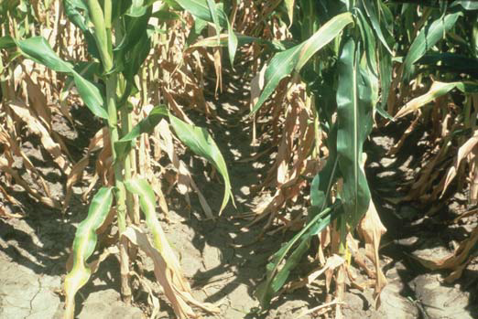
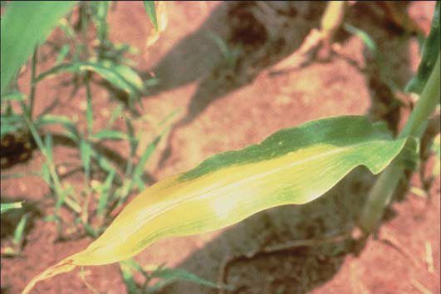
Corn Case Study 1
Primary Information
The farmer reports that his corn grows in sandy soil. The plants are stunted and have yellow leaves. They are free of pests, and the fields are free of weeds. The farmer provided the following photograph.
Secondary Information
The farmer sent this additional photograph of an affected leaf. He reports that his fields have been exposed to heavy rains and higher than normal temperatures.
Notes:
Teacher notes:
Reconvene the class and discuss each case study in turn, asking students how they arrived at their diagnosis.
Write the students’ diagnoses on the board.

Slide 10
Corn Case Study 1
From Primary Information
Important information
Diagnosis
Matching symptoms
After reading Secondary Information
Is your initial diagnosis confirmed?
If not, what is your new diagnosis?
If not, what cause you to change your diagnosis?
Stunted, yellow leaves; sandy soil
These symptoms are consistent with either nitrogen or potassium deficiency. The yellowed leaves seem to have the V-shaped pattern associated with nitrogen deficiency.
Stunted, yellow leaves; sandy soil
Answers will vary.
Answers will vary.
The second photograph shows a leaf with the V-shaped pattern of yellowing that is consistent with nitrogen deficiency. The fact that the fields have been exposed to heavy rains further supports the nitrogen-deficiency diagnosis. If not, what caused you to chance your diagnosis?
Notes:
Teacher notes: Page 124
Click through the answers to aid your discussion.

Slide 11
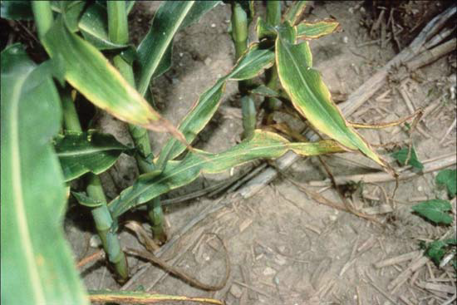
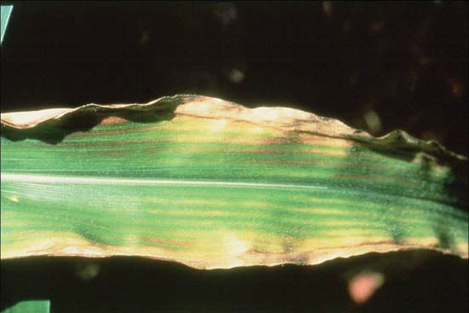
Corn Case Study 2
Primary Information
The farmer reports that the plants are stunted. Her corn grows in sandy soil. Some weeds are present in the fields. She provided the following photograph, which shows some yellowing of leaves.
Secondary Information
The farmer sent this additional photograph of a leaf from an affected plant. She also reports that some of her plants have stems that aren’t strong enough to support the ears of corn.
Notes:
Teacher notes:
Ask students how they arrived at their diagnosis for case 2.
Write the students’ diagnoses on the board or exit the presentation and type within each table for each case study.

Slide 12
Corn Case Study 2
From Primary Information
Important information
Diagnosis
Matching symptoms
After reading Secondary Information
Is your initial diagnosis confirmed?
If not, what is your new diagnosis?
If not, what cause you to change your diagnosis?
Stunted, yellow leaves; sandy soil
These symptoms are consistent with either nitrogen or potassium deficiency.
Stunted, yellowing leaves; sandy soil
Answers will vary.
Answers will vary.
The second photograph shows a yellowed leaf with dried edges that are consistent with potassium deficiency. The fact that the plants have weak stems further supports the potassium-deficiency diagnosis.
Notes:
Teacher notes: page 125
Click through the answers to aid your discussion.

Slide 13
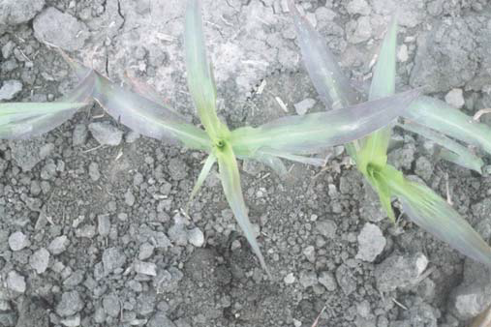
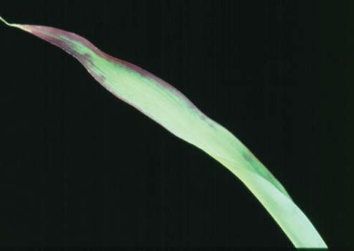
Corn Case Study 3
Primary Information
The farmer reports that her plants are stunted. Her fields are composed of compacted (dense) soil and are free of weeds. She provided the following photograph of two affected plants.
Secondary Information
The farmer sent this additional photograph of a leaf from an affected plant. The discoloration seen
near the tip of the leaf is purplish. She reports that her corn is maturing later than it should and that she is beginning to see some weeds growing in her fields.
Notes:
Teacher notes: Page 125
Ask students how they arrived at their diagnosis for case 3.
Write the students’ diagnoses on the board or exit the presentation and type within each table for each case study.

Slide 14
Corn Case Study 3
From Primary Information
Important information
Diagnosis
Matching symptoms
After reading Secondary Information
Is your initial diagnosis confirmed?
If not, what is your new diagnosis?
If not, what cause you to change your diagnosis?
Stunted, compacted (dense) purple color on some leaves
The symptoms are consistent with phosphorus deficiency.
Stunted, compacted (dense) soil; purple color on leaves
Answers will vary.
Answers will vary.
Plants mature later than normal. The second photograph of a leaf shows distinct purple coloration, which is characteristic of a phosphorus deficiency.
Notes:
Teacher notes: Page 125
Click through the answers to aid your discussion.

Slide 15
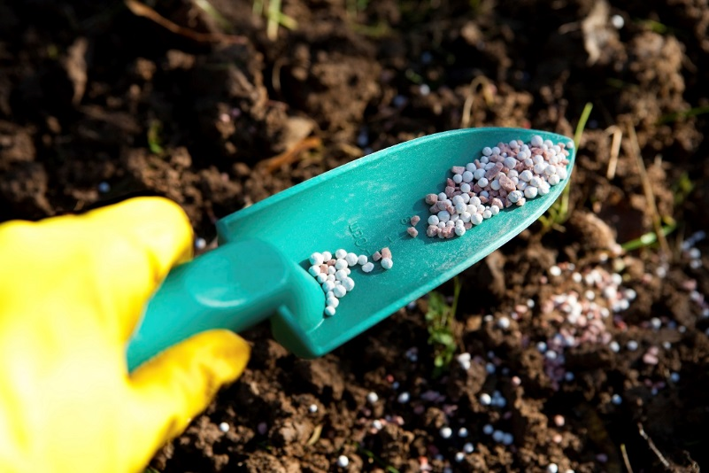
Research & Write
Instructions:
Nutrient deficiencies can be remedied through the use of fertilizers. Research and write a short paper that describes how to interpret fertilizer labels and correctly apply fertilizers to ensure economic, social and environmental sustainability.
Notes:
Allow students time to complete the writing or assign as homework.

Slide 16
Crops, Soil, and Nutrients
Notes:
Pass out Master 4.5 (page 143-144). Part of this handout is represented on the slide, but students will probably find it helpful to have the full handout.
Allow time for students to work in their teams of 3 to analyze the graph and answer the questions on the handout.
Encourage students to discuss their ideas with their team members.
Depending on your students, it may be helpful to look at the graph on Master 4.5 with the whole class before they begin answering the questions in their teams. The y-axis on the graph indicates the change in amount of a nutrient; it does not indicate the total amount of the nutrient in the soil. Zero on the graph indicates the starting amount of nutrients in the soil before crops have grown. This does not mean that the soil did not contain any nutrients. The direction from zero indicates whether there is more of a given nutrient in the soil after the crop has grown or whether there is less. For each nutrient and each crop represented on this graph, the level of nutrients in the soil is lower after the crops grow as indicated by bars that go down from the starting level.
Hold a brief class discussion to review answers to the questions on Master 4.5 And To Check Their Understanding.
For this activity, the crop yields were based on an average yield for each crop grown in this country. However, yields will vary depending on a variety of factors including soil quality, water availability, and temperature, among others.
Some students may have difficulty envisioning what a bushel is. If they are interested, you can tell them that a bushel of corn is approximately 56 pounds. A bushel of either soybeans or wheat is approximately 60 pounds.
Sample responses to questions on Master 4.5, Crops, Soil, and Nutrients:
1. What happened to the level of nutrients in the soil after growing the crops ? In each case, nutrients were removed from the soil after the crops grew. The amount of each nutrient removed from the soil depended on the particular crop.
2. How would the levels of each major nutrient be changed if the farmer grew 100 acres of the crop? 1,000 acres of the crop?
The goal of this question is to help students think about scale. They simply need to multiply the amount of each nutrient by 100 or 1,000 to answer these questions. If you wish, students could convert kilograms to pounds if they do not have a good idea of the amount. (One kilogram = 2.2 pounds.)
3. What might happen to the crops if the farmers plant their crops in this soil again in future years ?
In the scenario, the farmers started with nutrient-rich soil, which was depleted of nutrients when the crops grew. When they planted crops in the soil the next year, it is possible that the soil would not have enough of the nutrients remaining to meet the plants’ needs. Even if the soil contained sufficient amounts of each nutrient the second year, over time, it is likely that the soil would become depleted and the plants would show signs of nutrient deficiencies.
4. What actions might the farmers need to take if they want to continue getting good harvests from their crops in the future ?
Students are likely to mention adding fertilizer to the soil to replace the nutrients that have been removed from the soil. Some students may specify commercial or organic fertilizers. Explain that they will explore the advantages and disadvantages of these fertilizers in the next lesson.
TEACHER NOTE
The data for the graph on Master 4.5 were obtained using the Nutrient Crop Tool on the USDA website (http://plants.usda.gov/npk/main). On this site, you can investigate nutrient needs for a wide variety of plants and you can adjust for number of acres and crop yield.

Slide 17
Is calcium an essential element for plants?
Notes:
Extension Activity: Investigating Calcium Deficiency (Optional, page 127)
Preparation: There are several ways of carrying out this optional extension activity. The procedure calls for students to plant pea seeds and then do the hands-on investigation. This will take class time over a couple of weeks. Another option is for you to plant the pea seeds and then, when the plants are a few days old, have the students take over to do the experimental treatment of the plants. Both of these options present good hands-on experiences for students and emphasize several practices of science. If class time is limited, you could have students analyze the photographs of the pea plants on Master 4.9, EDTA Effects on Pea Plants, rather than conducting the activity in a hands-on manner.
This activity uses ethylenediaminetetraacetic acid (EDTA) to mimic a calcium deficiency for plant growth. EDTA chelates divalent cations such as Ca++ thereby making calcium unavailable to the growing plants. EDTA can be purchased from a scientific supply company. You should purchase ethylenediaminetetraacetic acid, disodium salt, dehydrate (C10H14N2Na2O8 • 2H2O) that has a molecular weight of 372.24. Because this chemical is used in molecular biology experiments, you may already have it in your supplies. If you have 10 teams of students, 1 L each of 25 and 5 mM EDTA solution should be adequate. If you have more or fewer teams, you can adjust accordingly.
PREPARE 1 L Of AT 25 mm EDTA SOLUTION AS FOLLOWS:
Add approximately 800 mL of tap water to a large beaker.
Add 1 N NaOH solution to raise the pH of the water to 8.
Slowly add 9.3 g of EDTA to the water in increments, waiting until it dissolves before adding more.
If the EDTA does not go into solution, check the pH and add more NaOH if necessary (pH needs to
be basic).
After all of the EDTA is in solution, check the pH again. The pH does not need to be exact but should
be between 7 and 8.
Add water so that the final volume of solution is 1,000 mL (1 L).
PREPARE 1 L Of 5 mm EDTA SOLUTION AS FOLLOWS:
Pour 200 mL of 25 mm EDTA solution (prepared above) into a separate graduated cylinder.
Add water to a final volume of 1 L (1,000 mL).
Point out that calcium is considered an essential nutrient for plants. Ask students to predict (in general terms) what they think might happen if a plant does not have its need for calcium met. Based on what they learned in Activity 2, students should suggest that there would be some physical manifestation of calcium deficiency that could be observed as a change in color, size, or overall health of the plant.
Explain to students that they are going to investigate how calcium deficiencies affect plant growth. They are going to use a chemical called EDTA (ethylenediaminetetraacetic acid) to create a calcium-deficient environment for plants experimentally. Inform students that EDTA is a calcium chelator—in simple terms, EDTA binds the calcium in a way that makes it unavailable to the plant.
Master 4.6, Investigating Calcium Deficiencies, calls for student teams to begin the activity by planting pea seeds. To conserve class time, you could plant seeds ahead of time (about 5–7 days before beginning EDTA treatment). The seedlings should be approximately 5–7 cm tall when students begin the EDTA treatment. You can continue with the rest of the module’s lessons while this investigation progresses (an additional 5–7 days should be adequate to see the effects of EDTA). Remember to plant more seeds than needed to account for any that do not germinate, and also to allow teams to select plants for treatment and control that are approximately the same size.

Slide 18
What effects does calcium deficiency have on the growth of pea plants?
Notes:
Page 128
Ask the class, “What effects does calcium deficiency have on the growth of pea plants?” Inform students that they will answer this question experimentally.
Having this question visible where students can refer to it will help keep the testable question in students’ minds and help focus their attention.

Slide 19
Discussion
Why are we watering some plants with tap water, rather than water containing EDTA?
Why would we wait until the peas are about 5-7 cm tall before starting the treatment with the EDTA solution?
What types of evidence will we be collecting?
Why would we need to keep this experiment going over several days?
Notes:
Give Each Student 1 Copy Of Master 4.6, Investigating Calcium Deficiencies.
Review the steps in the procedure with students and guide a discussion using questions such as the following to make sure they understand the experimental design .
Q: Why are we watering some plants with tap water, rather than water containing EDTA?
A: The plants watered with tap water serve as a control.
Q: Why would we wait until the peas are about 5-7 cm tall before starting the treatment with the EDTA solution?
A: If you began watering with EDTA at the beginning of the experiment, you would be investigating what effect calcium has on germination, which could be different than the effects on growth and appearance.
Q: What types of evidence will we be collecting?
A: Students will be collecting both empirical data (height of plants) and observational data (color, overall appearance of plants).
Q: Why would we need to keep this experiment going over several days?
A: The effects will not be seen immediately. Growth of plants occurs slowly over time, so any effect on growth will most likely take some time to become apparent.

Slide 20
After one week of treatment
5 mm EDTA |  | 25 mm EDTA |  | Tap Water
Starting Height (cm) | Final Height (cm) | Starting Height (cm) | Final Height (cm) | Starting Height (cm) | Final Height (cm)
Notes:
Ask students to work in teams of 3 for this activity. Allow time for teams to plant the pea seeds that will begin the experiment. Teams will need to make sure that the cups holding the seeds are watered periodically so they do not dry out. It will take approximately 5-7 days after planting until the seedlings are 5-7 cm tall and ready for the experimental treatments to begin. Once the treatments begin, teams should see results in about 1 week.
If the pea plants start getting tall and falling over, you may want to use a skewer or stick to keep each plant upright and not falling down and getting tangled with other plants.
If appropriate, encourage students to take photographs of the plants as an additional way to record data. At the conclusion of the experiment, ask students to record final observations on their data chart. Next, ask students to record their information on a class chart similar to the following. Provide a place where students can record observations to share with the class. after all teams have added their data to the class data chart, instruct them to calculate average values for each column.

Slide 21
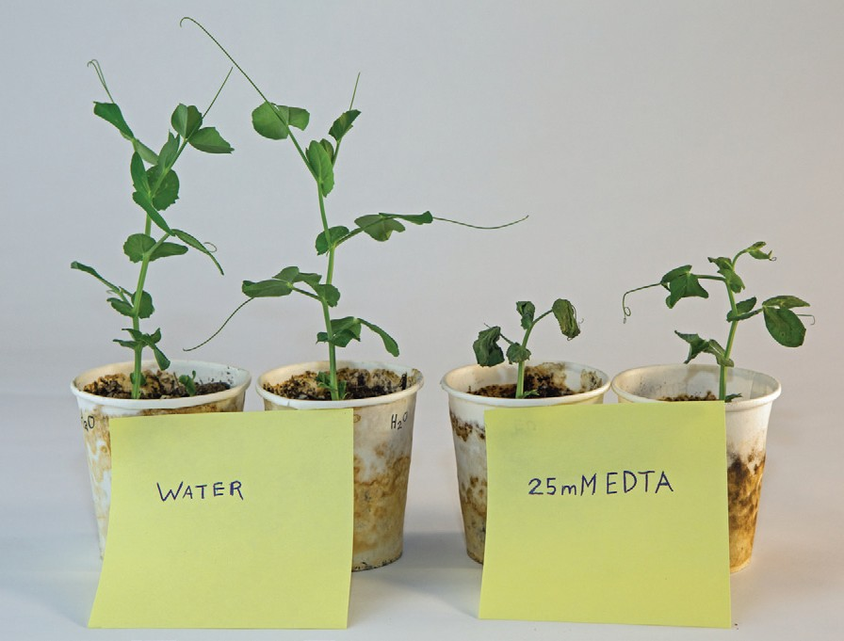
Before and After Treatment
What did you observe?
Notes:
Conduct a class discussion that summarizes the effects of calcium depletion that were observed as part of the investigation.
The data that they collected about plant height will likely reveal that plants watered with EDTA did not grow as tall as plants watered with tap water and that the plants watered with 25 mM EDTA were more severely affected than plants watered with 5 mM EDTA. In addition, students should have observations about the leaves or other parts of the plants that they can share.

Slide 22
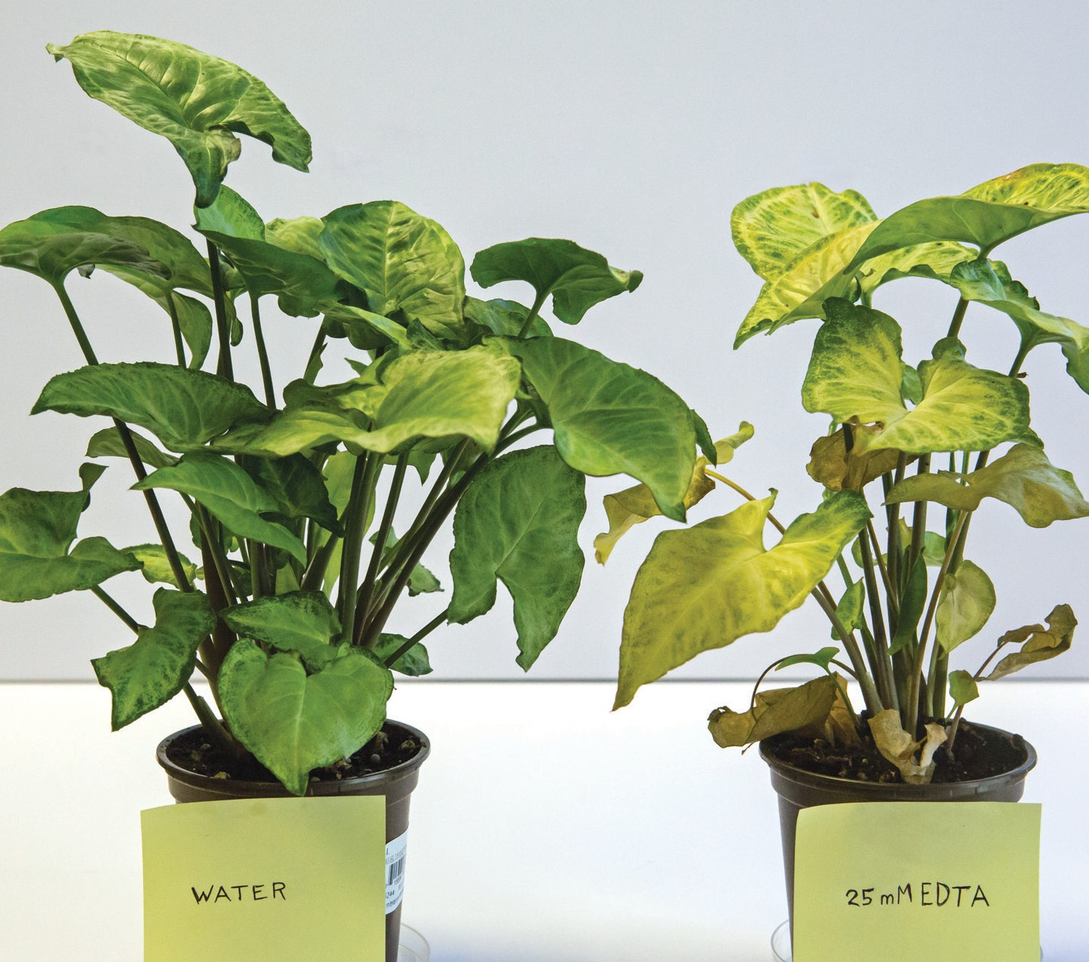
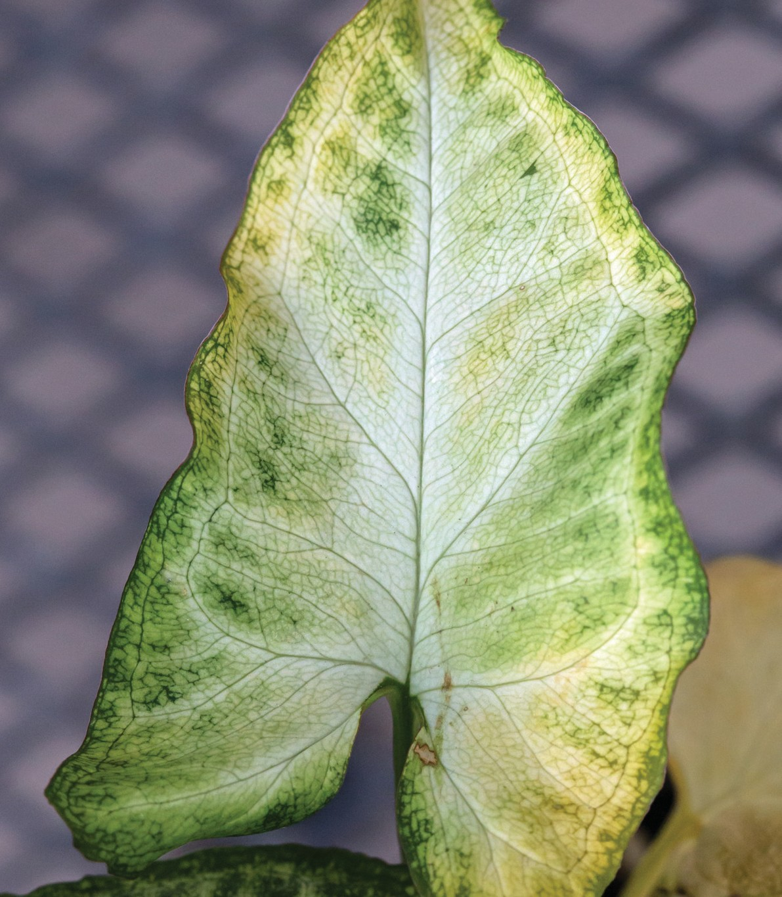
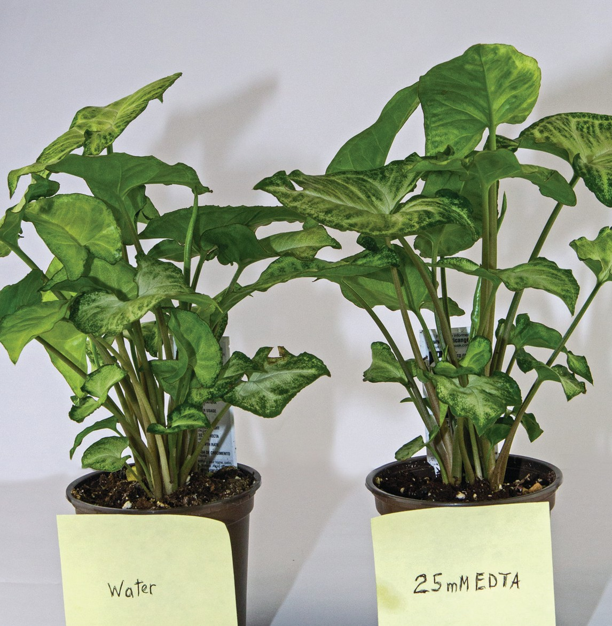
Additional Experimental Results
After experimental treatment: 25 mM EDTA
Before experimental treatment: water
Before experimental treatment: water
Notes:
Master 4.7 Additional Experiment Results - Page 147
Explain that this slide shows photographs of plants that were watered with either tap water or 25 mm EDTA. Ask students to make observations from the photographs. record observations on the board or chart paper.
Students will notice that both plants looked healthy and were bushy and green before the experiment started.
At the conclusion of the experiment, students should observe that the control plant (tap water) remained healthy, green, and bushy. The plant treated with 25 mm EDTA seems to have many dead leaves near the base, fewer leaves, and the remaining leaves are less green and there may be some dead or dying areas around the edge of the leaves.

Slide 23
Calcium and Plant Growth
You probably know some of the reasons why calcium is important in the human body. Calcium helps form and maintain healthy teeth and bones. You may be less familiar with some other roles for this important element. Calcium also plays a role in the clotting of blood, the sending and receiving of nerve signals, muscle contraction and relaxation, and regulating the release of certain hormones and other chemicals in the body.
In plants, calcium is a constituent of cell walls and is involved in the new growth of leaves and root tips. It provides elasticity and expansion of cell walls, which prevent the growing points from becoming rigid and brittle. As scientists continue to study the role of calcium in plants, they find that calcium is important in many plant functions ranging from nutrient uptake to coordinating changes in the cells that help the plant react to the impact of environmental changes and stresses.
Calcium deficiencies in plants generally appear in areas of new growth, such as leaves, stems, buds, and roots. Young leaves may be deformed. Areas around the edge of the leaf may die or the entire leaf may die. In older leaves, dead (necrotic) spots may develop.
In plants like tomatoes and peppers, calcium deficiency causes a disorder called blossom-end rot. In such cases, a black leathery spot appears on the blossom end of the fruit. The fruit then stops developing and eventually falls off. In peanuts, low calcium levels cause a condition that prevents nuts from developing.
Calcium deficiencies also affect roots. Roots may be short, stubby, and misshapen. In severe cases, root tips may die.
Notes:
Page 148
Pass out to each student 1 copy of Master 4.8, Calcium And Plant Growth, or read from the slide. Explain that this handout provides additional information about the role of calcium in plants and the effects of calcium depletion. Ask students to remember their experimental results as they read this new information. This reading provides a brief overview of some of the effects of calcium depletion. Many of the effects of calcium deficiency are observed on the most actively growing parts of the plant.
The plant shown in Master 4.7 (after treatment with 25 mm EDTA) shows some of these traits. For example, you can see that there are many dead leaves around the base of the plant. These were new leaves that died before reaching maturity. In the older leaves, there were some spots and changes, but those took much longer to appear in the mature tissue compared with new tissues. Although not shown in the photographs, there were distinct changes in the root system of the EDTA-treated plant compared with the control plant. The roots were much less developed. In addition, when both plants were watered, the EDTA-treated plant did not take up as much water as the control plant.

Slide 24
EDTA EFFECTS ON PEA PLANTS

Slide 25
Soil Testing Assignment http://www.csrees.usda.gov/Extension/
Notes:
Optional Homework Assignment
Instruct students to work with a parent/guardian for this activity. They will obtain a soil sample from near where they live. They can use the phone book or the web to find an address for the local county cooperative extension office or state university that conducts soil testing. Students should send in their soil sample for analysis to assess its quality and to see if any essential nutrients are lacking. You can collect the soil analyses obtained by different students and see if there are any differences according to location.
Note that some states and universities will assess a fee for soil testing, which is typically no more than $10. Private organizations will charge more. Factoring in the time for the organization to conduct the test and prepare a report, this assignment is better used as a long-term project or science fair project.

