Slide 1
Notes:
Lesson 1: In Search of Essential Nutrients
Nourishing the Planet in the 21st Century
Download your free copy of the curriculum: https://www.nutrientsforlife.org/for-teachers
Students begin by comparing and contrasting the nutritional needs of plants and people.
Topics Covered and Major Concept
Engage: Students become engaged in how plants obtain their nutrition.
Plants and people require essential nutrients to complete their life cycles. Macronutrients are needed in larger amounts than micronutrients. Plants get their nutrients from water, air, and soil.
Alignment with Next Generation Science Standards
Science Practices in Lesson 1
Analyzing and Interpreting Data
Engaging in argument from Evidence
Obtaining, Evaluating, and Communicating Information
Disciplinary Core Ideas from the Next Generation Science Standards:
LS1:C: Organization for Matter and Energy Flow in Organisms: The sugar molecules thus formed contain carbon, hydrogen, and oxygen, their hydrocarbon backbones are used to make amino acids and other carbon-mased molecules that can be assembled into larger molecules (such as proteins or DNA) used, for example, to form new cells.
LS2.B: Cycles of Matter and Energy Transfer in Ecosystems: The chemical elements that make up the molecules of organisms pass through food webs and into and out of the atmosphere and soil, and recombine in different ways.
LS2.C: Ecosystem Dynamics, Functioning, and Resilience: Moreover, anthropogenic changes (induced by human activity) in the environment – including habitat destruction, pollution, introduction of invasive species, overpopulation, and climate change – can disrupt an ecosystem and threaten the survival of some species.
Crosscutting Concepts in Lesson 1:
Patterns and Energy/Matter in Systems.
Common Core Standards in Lesson 1
English Language Arts/Literacy
Anchor Standards
CCSS.ELA-Literacy.CCRA.R.1
CCSS.ELA-Literacy.CCRA.SL.1
CCSS.ELA-Literacy.CCRA.SL.2
The Nutrients for Life Foundation provides a search tool on their website, https://www.nutrientsforlife.org/, allowing teachers to select their state and find soil science lessons that correlate with their state’s science standards. The search tool can align this curriculum with science standards for all 50 states, National Sciences Education Standards, Common Core State Standards, and Next Generation Science Standards.
Students come to learning situations with prior knowledge. This knowledge may or may not be congruent with the concepts presented in this module. The Engage lesson provides the opportunity for teachers to find out what students already know, or think they know, about the topic and concepts to be covered. The Engage lesson in this module, LESSON 1, IN SEARCH Of ESSENTIAL NUTRIENTS, is designed to
pique students’ curiosity and generate interest,
determine students’ current understanding about nutritional requirements,
invite students to raise their own questions about essential elements,
encourage students to compare their ideas with those of others, and
enable teachers to assess what students do or do not understand about the stated outcomes of the lesson.

Slide 2
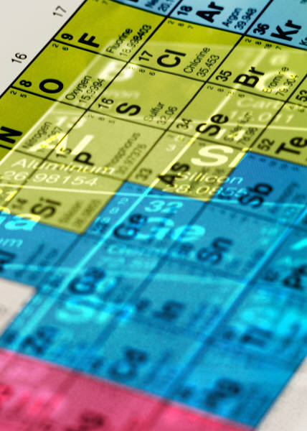
In Search of Essential Nutrients
Lesson 1
Engage
Notes:
Overview
Students explore the meaning of essential elements. They use periodic tables to compare the elements that are essential to people and plants. Students make predictions as to where in the environment plants obtain each of their essential elements.
Major Concepts
Plants require 17 essential elements to complete their life cycle.
Plants and humans require similar sets of essential elements.
Plants obtain their essential elements from air, water, and soil.
Teacher Background
Consult the following section in teacher background:
2.0 Plants And Their Essential Elements, 3.0 The Nitrogen Cycle
See pages 46-54 in Nourishing the Planet in the 21st Century high school curriculum for preparation instructions.

Slide 3
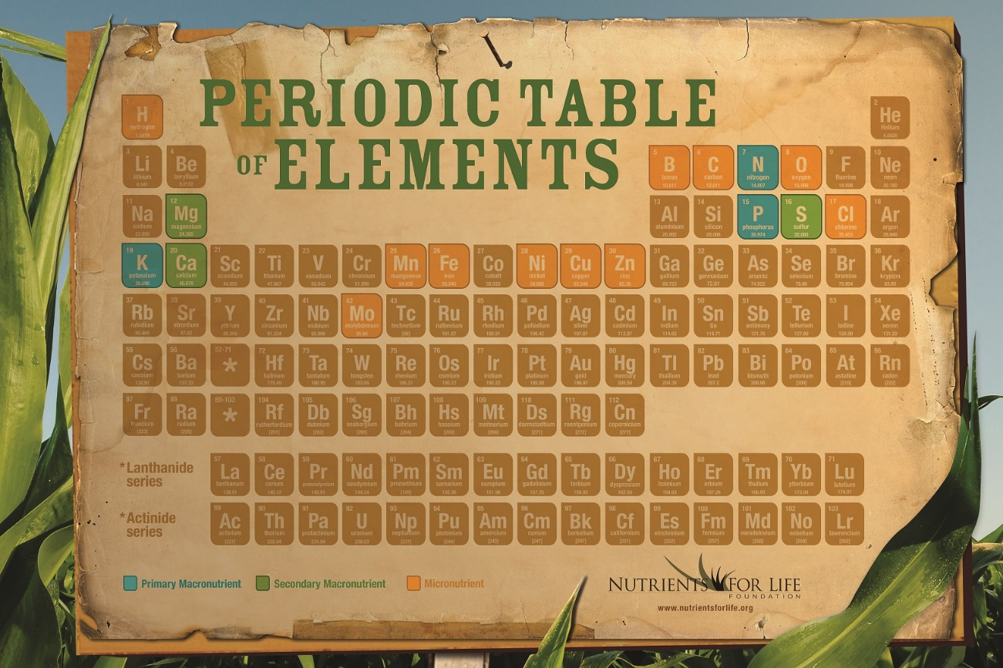
What we’re learning!
By the end of this lesson, you’ll be able to:
Define an essential element,
Compare and contrast the essential element requirements of plants and humans,
Explain why plants cannot use elemental nitrogen found in the atmosphere, and
Identify the sources for each essential element needed by plants.
Notes:
Lesson 1: In Search of the Essential Nutrients
Page 46
Objectives
After completing this lesson, students will be able to
define an essential element,
compare and contrast the essential element requirements of plants and humans,
explain why plants cannot use elemental nitrogen found in the atmosphere, and
identify the sources for each essential element needed by plants.

Slide 4
Virtual Classroom – Lesson Introduction
Notes:
For more virtual classroom videos, visit the Nutrients4Life YouTube channel.

Slide 5
What do humans need to live?
Humans need:
Notes:
Activity 1: Essential Elements (page 48)
TEACHER NOTE
Remember, it is not important to discuss each essential element; rather, you should focus on those elements that are important in building proteins, nucleic acids, and carbohydrates.
In this activity, students use the periodic table to express their prior knowledge about what plants need to survive. Their predictions are compared to a list of essential elements known to be important to plant health. Begin the lesson by explaining that scientists who are interested in studying human health must understand the specific needs of the body.
Ask students, “What do humans need to live?”
Accept all answers. Write student responses on the board or on chart paper. Direct the discussion to elicit air (oxygen), water, and food. Some students may realize that sleep is also required for survival. Other students may suggest environmental conditions, such as temperature and pressure or material things such as clothing and shelter.

Slide 6
What do humans consume from the environment for survival?
Why do we need air, water, and food to survive?
Water is the medium in which life has evolved.
Human cells are mostly water.
Water is the chemistry of life.
Energy & chemical building blocks of cells.
Humans require oxygen for cellular respiration.
Notes:
Students should recognize that from the list generated, in the previous step, air, water, and food are obtained from the environment.
Ask students, “Why do we need each of these (air, water, and food) to survive?”
Students should report that oxygen in the air is needed for cellular respiration and be able to explain that our cells are mostly made of water. Water is the medium in which life has evolved. It is required for the chemistry of life. Students should recognize that food has two critical functions: as a source of chemical energy and as a source of chemical building blocks needed by our cells.

Slide 7
Do plants need food?
Notes:
Remind students that humans (and animals) eat plants and other animals to obtain chemical energy and provide them with the building blocks needed by their cells. Ask students, “What about plants; do plants need food?”
Some students may respond that plants do not need food, because they can obtain energy from photosynthesis. Other students may mention that plants need water or that they obtain nutrients from the soil. If not mentioned by a student, remind the class that fertilizer can be considered “food” for plants, because it provides nutrients that plants need to live and grow.
TEACHER NOTE
In many things you may read online, the terms “essential elements” and “essential nutrients” are often used interchangeably. A nutrient is a substance that organisms need to live and grow. In this activity, the term essential elements will be the preferred term because students will be looking at the periodic table of elements. Elements often combine into larger molecules that living things use. For example, water is an important nutrient for organisms; water is made up of the elements hydrogen and oxygen.

Slide 8
An Essential Element
Is required for a plant to compete its life cycle;
Cannot be replaced by another element;
Is directly involved in the plant’s metabolism; and
is required by many different plants.
Notes:
Master 1.1 (Page 56)

Slide 9
Essential Plant Nutrients
Notes:
Master 1.2 (Page 57)
Discuss the vocabulary word, “nutrient.”
Instruct the class to consider the definition of “Essential Element.”
Which of these elements on the periodic table are necessary for plant growth? If possible, students should provide an example of how a given element is used by the plant. For instance, the plant’s use of nitrogen makes proteins and phosphorus is used to make ATP. Using the pen tool, circle the elements identified by the class.
Students likely will not be able to suggest a function for elements needed in trace amounts. Many such elements are needed as cofactors for enzymes. It is not important to discuss the uses of each element, but it is important that students understand that these elements are needed to build cell structures and to carry out the cell’s chemistry through enzymatic reactions.
This step gives you an opportunity to assess how well students can relate their knowledge of chemistry to biology. For example, students may respond that carbon is used to make carbohydrates, such as sugar. Students are not expected to identify the complete list of essential elements. Their responses however, will reflect their relative knowledge about the biology of plants.
When the class is finished making informed decisions, press the next arrow. The shaded-in element chart will appear with yellow coloring, while keeping the pen tool circles. Compare and discuss the results with the class.
Students likely will be surprised that so many elements are essential for plant growth. The comparison between the elements predicted by the students and the accepted ones should show some overlap. Students should be expected to identify carbon (C), hydrogen (H), nitrogen (N), oxygen (O), phosphorus (P), and sulfur (S) because these elements serve as building blocks for biomolecules. If necessary, ask guiding questions to connect these elements to the synthesis of proteins, nucleic acids, and carbohydrates.

Slide 10
Essential Plant Nutrients
Essential element for humans

Slide 11
Essential Elements for Humans
Essential Element for Humans
Notes:
Master 1.2 (Page 57)

Slide 12
Essential Elements for Humans & Plants
Essential Element for Plants and Humans
Essential Element for Plants
Essential Element for Humans
Notes:
Master 1.2 (Page 59)
Students should notice that the essential elements for humans and plants are more alike than different.

Slide 13
Sources of Essential Elements
Notes:
Activity 2: Sources of Essential Elements (page 50)
Ask a student volunteer to describe which elements he or she listed as coming from water.
Activity 2 (page 50) & Master 1.5 (page 60): Put a “W” next to the elements named by the students. Of course, students should mention hydrogen and oxygen. Actually, rainwater may contain small amounts of other elements derived from atmospheric gases and dust particles. Other elements that could be mentioned include C, Cl, N, and S.
Ask another volunteer to describe which elements he or she listed as coming from the air.
Put an “A” next to the elements named by the students. Students should recognize that the corn plant obtains carbon and oxygen (via CO2) from the air. Some students may know that most of the atmosphere is nitrogen. Most students will not realize that nitrogen gas is not available to the corn plant in a usable form. Do not correct this misconception yet. This issue will be addressed in Step 7. As with water, small amounts of other elements also may be present due to air pollution.
Ask another volunteer to describe which elements he or she listed as coming from the soil.
Put an “S” next to the elements named by the students. Students should list most, if not all, of the essential elements. The soil not only contains many elements that reflect its geological history, but it also contains organic material from once-living plants and animals as well as from the abundant life (both macro and micro) that resides there.
Ask students to help you summarize where the corn plant gets its essential elements. Answers to Master 1.5, Sources of Essential Elements on page 50 of Nourishing the Planet in the 21st Century. Students should report the following:
Water: hydrogen and oxygen
Air: carbon and oxygen
Soil: all essential elements
Ask students to work individually or in pairs to write a short summary before holding a class discussion. This will allow students to gather their thoughts before speaking and for you to assess each student’s understanding.

Slide 14
Sources of Essential Elements
S
S
A
S
S
S
A
W
S
S
S
S
S
S
S
A
W
S
S
S
S
S
Notes:
Master 1.5 page 60

Slide 15
Where does a corn plant obtain nitrogen?
Notes:
Master 1.6 – page 61
Explain that nitrogen is an essential element that plants need in relatively large amounts. Pass to each student one copy of Master 1.6, Using Nitrogen. Instruct students to read the description and answer the questions.
After students have completed their tasks, ask them, “In light of what you just read, would you change your prediction of where the corn plant obtains its nitrogen?”
Students should change their answer, if necessary, to indicate that the corn plant must obtain its nitrogen from the soil rather than from the air.

Slide 16
Notes:
Master 1.6 – page 61
Explain that to grow healthy crops, farmers need to know which essential elements are found in the soil and how much of each is present. Ask students to think about where the essential elements found in the soil come from.
Student responses will vary. At this time, accept all answers. If not mentioned, use guided questions to highlight that essential elements in the soil come from multiple sources that include:
natural ones, such as the erosion of rocks;
the action of lightning;
the decomposition of plant and animal material;
human-associated activities, such as runoff from fertilizers used by farmers and the public as well as from
waste that humans produce; and
emissions from industry and automobiles.
Explain that in the next lesson they will investigate the composition of soils, soil formation, and the interaction of plants with soil.

Slide 17
Using Nitrogen
What do you think is responsible for converting more of the nitrogen used by plants into a usable form?
Legumes
Such as peas and beans.
Symbiotic relationship with bacteria that live in their roots.
The bacteria use sugars from the plants to produce energy.
In return, the bacteria take nitrogen from the air and convert it to a form that the plants can use.
Why is this ability of legumes, to use nitrogen in this way, important to farmers?
Notes:
Ask for a volunteer to read his or her answer to question 1 & 2 on Master 1.6, Using Nitrogen.
Answers:
1. What do you think is responsible for converting most of the nitrogen used by plants into a usable form?
Students should conclude that bacteria are responsible for fixing most of the nitrogen used by plants. Some nitrogen also is fixed by lightning and industrial processes, but these are much smaller amounts.
2. Why is this ability of legumes, to carry out their own nitrogen fixation important to farmers?
Because the symbiotic bacteria in legumes fix additional nitrogen for plants to use, farmers can be less concerned with replenishing the soil using nitrogen-containing fertilizers.
Explain that to grow healthy crops, farmers need to know which essential elements are found in the soil and how much of each is present. Ask students to think of where the essential elements found in the soil come from.
Student responses will vary. Essential elements in the soil come from multiple sources that include:
Natural ones, such as the erosion of rocks;
The action of lighting;
The decomposition of plant and animal material;
Human-associated activities, such as runoff from fertilizers used by farmers and the public as well as from waste that humans produce; and
Emissions from industry and automobiles.

Slide 18
Humans, Food, and Essential Elements
Where do humans obtain their essential elements?
Most ingredients of food labels are chemical compounds composed of different elements. Select three ingredients on the food label and write them in the first column of the chart on the next slide.
Notes:
Optional extension activity: humans, food, and essential elements (page 52)
This activity requires a variety of different food labels and access to the Internet if carried out in the classroom. Alternatively, it can be assigned as homework.
Ask students to recall that plants get their essential elements mostly from the soil. Ask, “What about people? From where do they get their essential elements?”
Students should respond that people get most of their essential elements from food, though water gives us hydrogen and oxygen just as it does for plants.
Instruct students to obtain a food label from a nutritious food for analysis.
Since this activity concerns with diet and essential elements needed for good heath, food labels should come from healthy foods and not from snacks.
Have students retrieve their copies of Master 1.4, Essential Elements for Humans. Pass out to each student a copy of Master 1.7, Food Label and instruct them to follow the directions on the handout.
Some elements, including sodium, calcium, and magnesium are listed on food labels. However, most of the ingredients listed on a food labels are chemical compounds and not individual elements.

Slide 19
FOOD LABEL
INGREDIENT FROM FOOD LABEL | CHEMICAL FORMULA | ESSENTIAL ELEMENTS CONTAINED IN THE INGREDIENT
Notes:
Master 1.7: Food Label (Page 62)
With the pen tool, list any essential elements listed on the food label.
Most ingredients on food labels are chemical compounds composed of different elements. Select three ingredients on the food label and write them in the first column of the chart below.
Use the Internet to find the chemical formula for each of the three ingredients. Write the formula for each ingredient in the second column.
For each ingredient, list the essential elements that are part of its chemical structure.

Slide 20
List the essential elements found on the food labels:
1.
2.
3.
Notes:
Ask volunteers to list the essential elements found on their food labels. List them on the interactive board, as well as the chemical compound they come from.
Ask if other students found any additional essential elements to add to the list. As before, list the ingredient in which each essential element is found.
Ask students to compare the list of essential elements from their food labels to those shaded as essential on the periodic table on Master 1.4.
Students will see that the nutrition facts label on foods includes data about elements, such as calcium, iron, zinc, or manganese content. Students will see that food ingredients are the source of the 6 elements (C, H, N, O, P, and S) that are needed to make important biomolecules when they research the molecular formula.
For example, they will see that carbohydrates and fats are made up of carbon, hydrogen, and oxygen. Proteins also contain nitrogen, phosphorus, and sulfur. Many of the other essential elements that are not structural components of biomolecules are needed as cofactors for enzymes and are present in very small amounts.
Conclude the activity by asking, “What did this exercise teach you about health and diet?”
Students should recognize that their diet needs to contain a variety of foods to supply all the essential elements. Plants, as well as people, need a “balanced diet.”

